Slide 1
Featherweight Training
Eric Metzler
System Architect, CLA, CTA, CPI

Slide 2
What is it?
Actor Oriented Programming (AOP) Framework
Robust communications
Scalable
Main
Monitoring
Acq
Analysis

Slide 3
What is it not?
NI’s Actor Framework
Queued message handler

Slide 4
A Brief Intro to Actor Oriented Programming

Slide 5
Traditional Parallel Loops
How do they communicate data/state?
What if you need more than one of a loop?
What if they need to start/stop dynamically?
Main
Acq
Analysis
Monitoring

Slide 6
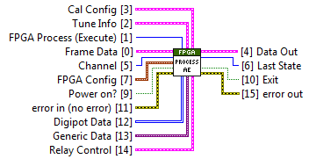
Action Engines…
Notes:
… and why I don’t like them
Problems:
Not (easily) scalable
Not inherently independently executing
Loose API
High coupling (action enum)
Limited API in/outs
Error prone DX

Slide 7
Dynamic Parallel Processes + Communication
Main
Monitoring
Acq
Analysis

Slide 8



Comparison
 | Action Engine | FTW Actor
Data Encapsulation
Reactive
Proactive
Strictly Typed API | By default | Optional
Low Coupling
Easily Scalable

Slide 9
How Do Actors Work?

Slide 10
FTW Actors
Event driven
API = actor connector
Inherit from base FTW actor class
Don’t have to use LV classes, but should

Slide 11
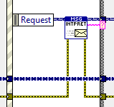


In-Process Communication
Queue
…

Slide 12
Network Communication
TCP
…

Slide 13
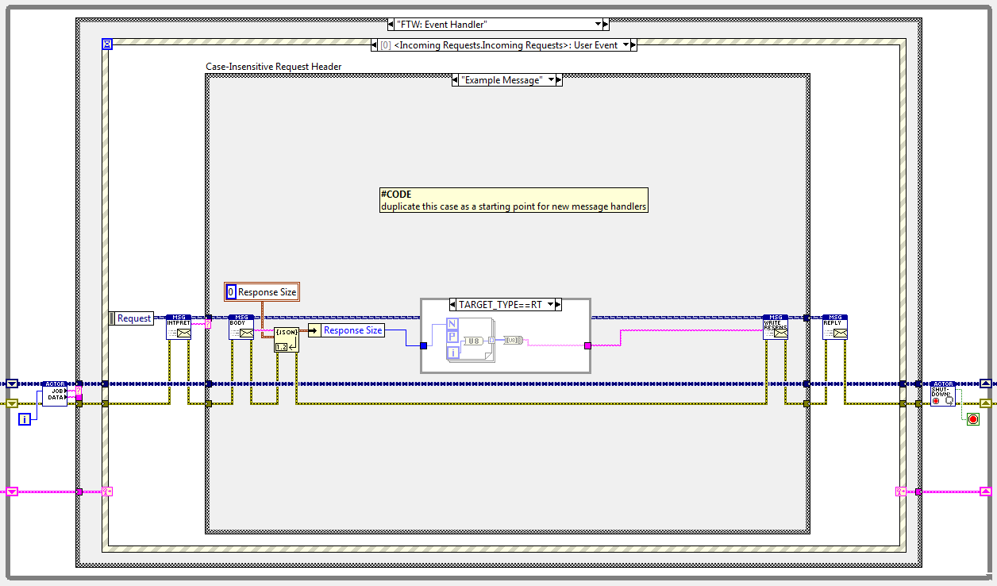
Actor Template

Slide 14
Basic Elements
Messages
Message transport (endpoint)
Process (actor)
Error/event handling
Application Plumbing

Slide 15
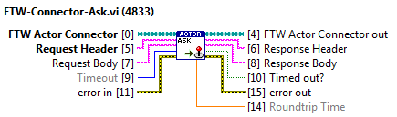
Message
String header
String body

Slide 16
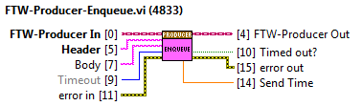

Socket
Transport for messages
Patterns
Protocols

Slide 17
Actor
Where the magic happens
Jobs = actions internal to actor
Events = user interface and external interface

Slide 18
Actor Template
Job Handler

Slide 19

Event Logging
[000002][000000.786sec][2015-09-23T16:46:56.595Z][Instance Initialized][Splashscreen][2015-09-23T16:46:56.595Z]
[000003][000002.115sec][2015-09-23T16:46:57.924Z][Instance Initialized][Status Cache][2015-09-23T16:46:57.923Z]
[000004][000002.121sec][2015-09-23T16:46:57.930Z][Instance Initialized][TSVN Toolkit][2015-09-23T16:46:57.929Z]
[000005][000002.121sec][2015-09-23T16:46:57.930Z][Instance Initialized][Bootstrapper][2015-09-23T16:46:57.930Z]
[000006][000002.122sec][2015-09-23T16:46:57.931Z][Global Init][__Default Project 99001][0x0F624CB0;;<Not A Path>]
[000007][000456.817sec][2015-09-23T16:54:32.626Z][Global Init][Temporary Project 1][0x0F83F280;;<Not A Path>][Error 1326: "mxLvErrorHandler.vi:2660001"]
[000008][000457.236sec][2015-09-23T16:54:33.045Z][Item Init][0x0F83FE20;;]

Slide 20
Sockets

Slide 21
Request-Reply
Connector sends a request
Actor replies with a message to the sender only
Lossless
N:1
2-way
Actor Connector
Actor
Actor Connector

Slide 22
Actor Connector
Base class contains utility methods
Connect
Destroy
Shutdown (PoisonPill)
Collection of custom methods that wrap the requests the actor knows how to handle
Not recommended to be a class

Slide 23
PubSub
Publisher broadcasts messages
Any and all subscribers receive message
Lossy by default
1:N
1-way
Parent Actor
Actor
Sibling Actor

Slide 24
Transports
Inproc
Intra-process communication
inproc://[connectionName]
TCP (Ethernet)
tcp://[ipAddress][:port]/[namedConnection]
Use either port or named connection, not both
0.0.0.0 listens on all NICs

Slide 25
Other Stuff
Connections are self-healing
Wildcards
Use * to randomize connection names
Useful when creating many instances of the same actor
i.e. inproc://* resolves to inproc://D84BE44EA2C980A0631ABBD0441DFCE0

Slide 26
Actor Configuration

Slide 27
Identity
InboxAddress
LoggerAddress
DebugShowFrontPanel

Slide 28
Debugging

Slide 29
Other Stuff

Slide 30
Recommended Folder Structure
source
Actor Name
Connector VIs
Public (used by VIs outside the actor) controls
core
Actor class
Actor VIs
[prefix]_Actor Name_Process.vi

Slide 31
Tips
Do use dynamic connection names and pass the connection
Do use the templates
Do write connector methods first
Do use clusters for passing data instead of base elements
Do reply quickly in actors
Do publish data/state up the foodchain
Do use requests to control actors down the foodchain
Do subscribe to multiple publishers using comma separated addresses
Do not put public controls in the actor class
Do not make a hierarchy of actor classes, inherit from base only

Slide 32
Specs
LV 2013+
Windows, Linux RT, and VxWorks*
*Disclaimer

Slide 33

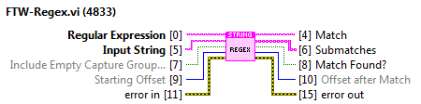


Useful Reuse VIs (very general)

Slide 34
Repos
Latest release
https://sc.viewpointusa.com/svn/featherweight/tags/1.1.0
Stable
https://sc.viewpointusa.com/svn/featherweight/trunk
“Less” stable
https://sc.viewpointusa.com/svn/featherweight/branches/develop

